Slide 1

ERHS –
Senior Year
Class of 2026

Slide 2



ERHS Seniors
℅ 2026
In this presentation, you can learn more about the
Counseling department and their role
SAT and ACT registration information
Letters of recommendation
Scholarships and financial aid
Reminders about upcoming senior events.
We commend all of you for your perseverance and dedication to working toward graduation and beyond. Let us know how we can support your efforts.
-ERHS Counseling Department

Slide 3

-Curriculum & Counseling Team-
  Jen Birtz, AP Curriculum birtz_jennifer@asdk12.org (907-742-2711)
  Cari Witte, Curriculum Assistant witte_cari@asdk12.org (907-742-2740)
  Tina Spano, Registrar spano_christina@asdk12.org (907-742-2708)
  Sally Laret, Counselor A-F laret_sally@asdk12.org (907-742-2704)
  Gina Wall, Counselor G-O wall_gina@asdk12.org (907-742-2712)
  Stephanie Rawlings, Counselor P-Z rawlings_stephanie@asdk12.org (907-742-2709)

Slide 4
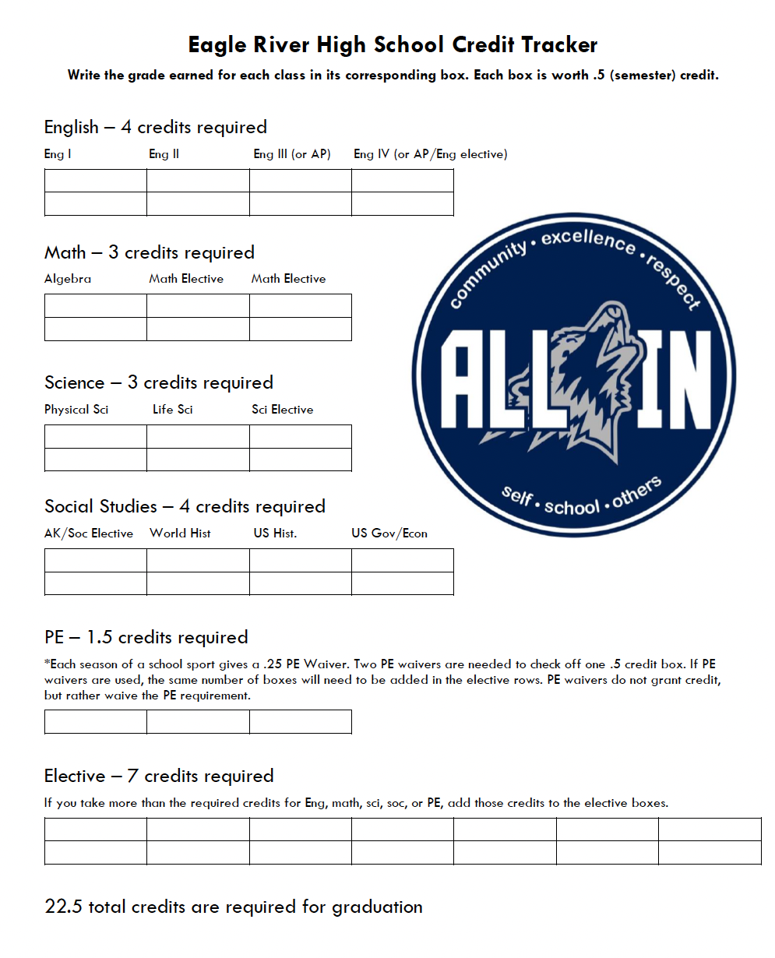
-Credit Tracker-
Click here for
ERHS Credit Tracker Form
(look under Student Tools) on the ERHS website
Each box is worth
.5 (semester)credit
22.5 total credits
required for graduation

Slide 5

-Transcript-
You can view your unofficial transcript through Q/parent/student connect.
To request an official transcript you will need to input your request at the link below.
This link is for official transcripts for:
personal use or to be sent to colleges, scholarships, or other institutions.
https://anchorageak.scriborder.com/
Transcripts must be requested online!

Slide 6

SAT/ACT – If you have not already taken one, sign up as soon as possible – more details on following slide.
Be sure to enter ERHS’s code (020368) when you sign up for the SAT/ACT. This allows your scores to be sent to the school district. (Required for APS)
SAT/ACT fee waivers are available to students who qualify for free/reduced lunch. Please contact your counselor or apply directly online.

Slide 7
2025-2026
SAT DATES
ACT DATES
www.collegeboard.org
www.act.org
Test Date | Registration Due | Late Fee Deadline | Location
October 4 | September 19 | September 23 | UAA
November 8 | October 24 | October 28 | UAA
December 6 | November 21 | November 25 | UAA
March 14 | February 27 | March 3 | UAA
May 2 | April 17 | April 21 | UAA
June 6 | May 22 | May 26 | UAA
Test Date | Registration Due | Late Fee Deadline | Location
October 18 | September 12 | September 30 | UAA
December 13 | November 7 | November 24 | UAA
February 14 | January 9 | January 23 | UAA
April 11 | March 6 | March 24 | UAA
June 13 | May 8 | May 29 | UAA
July 11 | June 5 | June 24 | UAA
SAT Cost: $68
Late registration fee: $44
ACT Cost $68
w/Essay $93
Late registration fee: $40
  Remember to enter ERHS’s code 020368 when you register for the SAT or ACT!

Slide 8

ASVAB & Practice SAT/ACT
ASVAB at ERHS will be Friday, 10/17 and Friday, 2/27
    Starts at 9:00am with interpretation immediately after.
    Students should plan to be here for about 3 hours.
    To sign up for the ASVAB, please see Ms. Witte in the Curriculum Office.
Frontier Tutoring will offer practice SAT and ACT tests virtually
    Practice ACT – 9/13, 10/24, 11/15, 12/20
    Practice SAT – 9/27, 10/17, 10/25, 11/1, 11/11, 11/29, 12/19
    To sign up for a practice SAT and/or ACT, go to the
    Frontier Tutoring Website.
    Spring 2026 dates TBD
ASVAB at ERHS will be Friday, 10/22/21 and Friday, 2/18/22
  Starts at 7:30am with interpretation immediately after. Students should plan to be here for about 3 hours.
Frontier Tutoring will offer practice SAT and ACT tests virtually.
  Practice ACT – 10/22, 2/18
  Practice SAT – 10/23, 2/19
To sign up for the ASVAB or practice ACT/SAT, please see Ms. Witte in the curriculum office.

Slide 9

-Letters of Recommendation-
  If you would like to request a letter of recommendation, please complete the “Request for Letter of Recommendation” form and submit it to the requested author.
    Printable Link HERE
    Check with the person you are requesting a letter from, because they may have their own process or form they prefer.
  Make sure to allow enough time (usually 2 weeks) for recommenders to write your letter. Plan ahead now!

Slide 10

-College Applications-
Narrow down the schools you want to apply to
  If you are not able to visit prospective schools in person, check out the many virtual tours available online!
Look at application deadlines and requirements
  Plan ahead – deadlines are often late November, early December.
If asked by the college/university, it is a good idea to waive your right to see counselor/teacher recommendations (FERPA waiver).
If you apply through Common App/Send EDU/or other similar site, please let your counselor know…so we can make sure your recommendations are complete.

Slide 11

-Alaska College & Career Fair-
Wednesday, 10/15/2025
Alaska Airlines Center
Connect with colleges, universities, training and apprenticeship programs, U.S. military, and employers.
For more info visit the UAA website
ERHS Permission Form

Slide 12

-Free Application for Federal Student Aid-
FAFSA – Application for 2026/2027 opens October 1, 2025
  ANY student requesting aid OR receiving a scholarship should complete
  the FAFSA.
  Needs based aid is first come, first serve – fill out the application ASAP.
How Financial Aid Works
Types of Financial Aid
FAFSA: Step-by-Step

Slide 13
-Scholarships-
Don’t rule yourself out. Every year there are scholarships nobody applies for. It is worth your time!
Approximately every other month, the ERHS Curriculum Department will email seniors a list of current scholarship opportunities. Please watch for these emails and pay close attention to scholarship deadlines.
ASD Scholarship Listing - check regularly, scholarship list is updated often and is organized by date due.
ERHS Scholarship bulletin board located in Senior Hall
AKCIS – Great place to check out options for college, careers, and scholarships. Students can set up their own profile after the initial login
ERHS Student Username: eagleriver / Password : 4Student

Slide 14

Scholarships
- and Other Helpful Information -
www.collegeboard.org
www.fastweb.com
www.scholarships.com
www.collegenet.com
www.frontiertutoring.com
  Free 1hr Math, Science, and English tutoring sessions
  Practice SAT/ACT testing
  Much More!

Slide 15
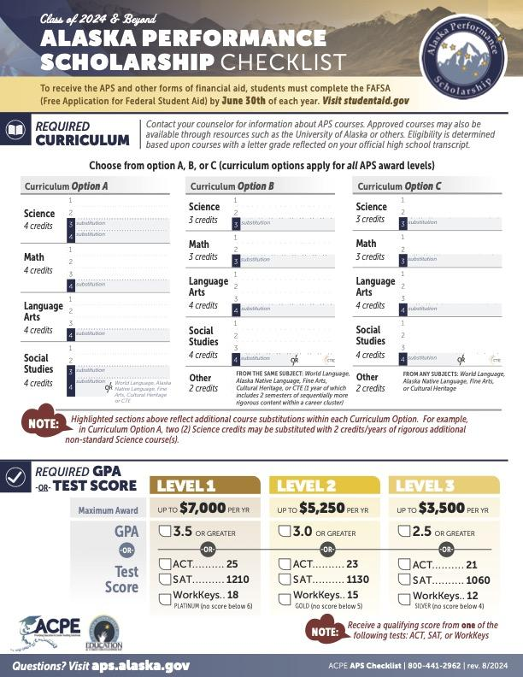
ALASKA PERFORMANCE SCHOLARSHIP
Up to $28,000!
Great Plan A or B
Available for 8 years after graduation
No competition - you only need to complete eligibility requirements and the FAFSA to earn the scholarship
Qualify by completing required classes and earning a high enough GPA or test score
Can be used at universities and many technical and training programs in Alaska (see list here!)
More information can be found here

Slide 16
-Western Undergrad Exchange (WUE)-
The Western Undergrad Exchange is a wonderful opportunity for students to attend out of state school for reduced tuition costs.
Check the WUE website for a complete list of participating colleges/universities.
Check individual colleges/universities for WUE guidelines, deadlines, and requirements (schools have the freedom to alter their awarding policies and procedures)
The Western Undergrad Exchange is a wonderful opportunity for students to attend out of state school for reduced tuition costs.
Check the WUE website for a complete list of participating colleges/universities. https://www.wiche.edu/tuition-savings/wue/
Check individual colleges/universities for WUE guidelines, deadlines, and requirements (schools have the freedom to alter their awarding policies and procedures)

Slide 17








-NCAA-
If you are planning to play a division I or II college sport, please make sure you have completed the requirements of the NCAA Clearing House.
Contact your counselor, if you have any questions and/or concerns.
Division I Academic Requirements
Division II Academic Requirements
Initial Eligibility Brochure
Registration Checklist
Guide for the College-Bound Athlete
DI & DII Course Planning Worksheets

Slide 18

-Graduation-
ERHS’s graduation ceremony will be tentatively May 12, 2026 at 6:30pm at the Alaska Airlines Center.
Stay up to date by checking the Senior Events Calendar!
First SENIOR meeting Thursday September 5th
@ 11am (during P3)!

Slide 19



-Reminders-
ERHS Yearbook
Senior Pictures must be submitted by November 21, 2025!
Check the ERHS weekly announcements
ERHS Announcements
Contact your counselor and/or curriculum department if you have any additional questions and/or concerns - we are here to help!

Slide 20
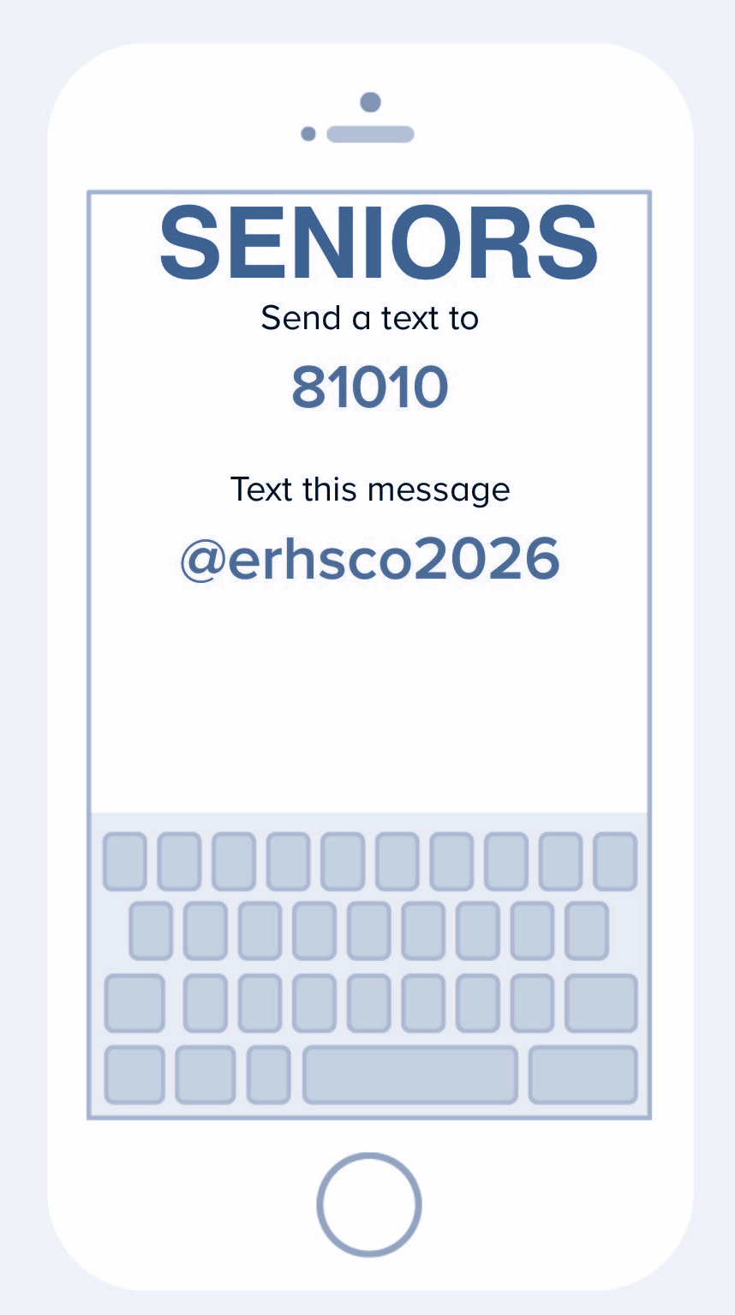
-Remind App-
Join the senior Remind group to stay up to date with important ERHS news for seniors!

Slide 21
Local Contacts
University of Alaska Anchorage
University of Alaska Southeast
University of Alaska Fairbanks
Northern Industrial Training
Alaska Pacific University
Alaska Vocational Technical Center (AVTEC)
Alaska Commission on Post-Secondary Ed
Alaska Career College
Charter College
Alaska Laborers Training School
Recruiters:
Air National Guard -Kristina Elliot. kristina.elliot@us.af.mil
Navy - Rico Velacruz, CE2, rico.h.velacruz1@navy.mil
Army - Matthew R. Kuhl, SFC, matthew.r.kuhl.mil@mail.mil

Slide 22
Other Useful Resources
Admissions Timeline for 11th/12th grade
Quick Guide to Financial Aid
Evaluating Financial Aid Award Letters
Financial Aid Tips
Scholarship Application Tips
More Scholarship Application Tips
Comparing Colleges
College Essay Tips
More Web Resources

